Slide 1
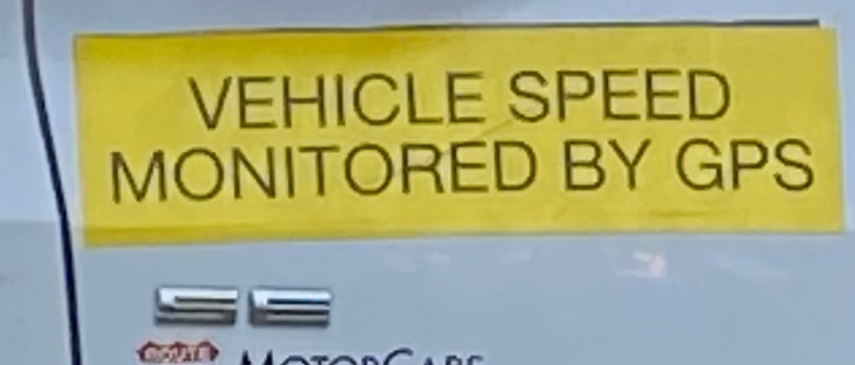
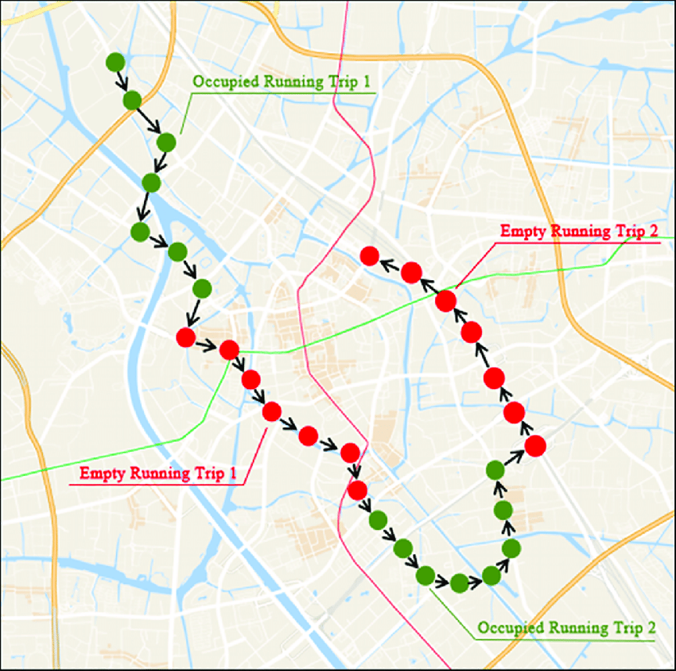
Use of Travel Time Data in and for Demand Modeling Sam Granato, for NCMUG, 11-15-2023

Slide 2
Topics for today:
Use of average travel times by (aggregated) road segments for model validation
Use of variability in travel times to estimate travel paths
Most current work done with GPS probe data, but – over the years - also floating car surveys and judicious use of spot speed data

Slide 3
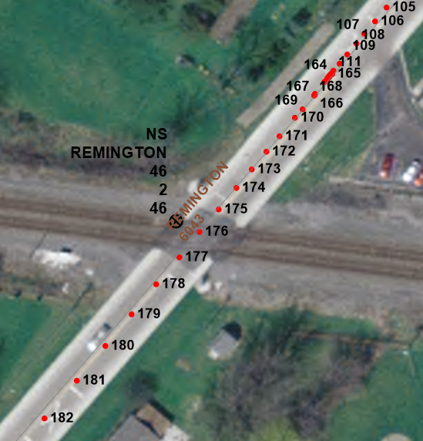
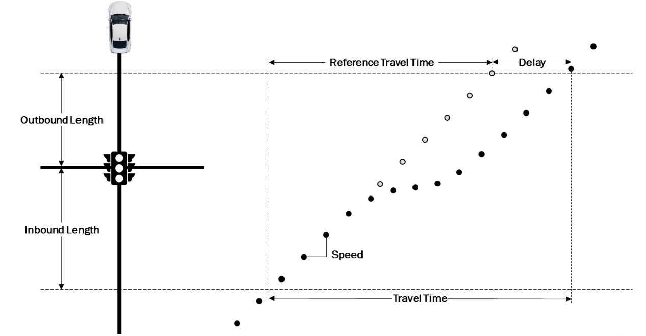
What’s the difference between GPS probe and other t.t. data, anyway?
Probe from series of time & location-stamped “waypoints” from vehicles (or on-board cell phones) at regular or irregular intervals, though not always at the best locations (intersections).
Amount of data available!

Slide 4
Why validate models for travel time?
Most important criteria for determining the travel path taken
The Level Of Service (LOS) metric for most roadway types, including urban streets

Slide 5
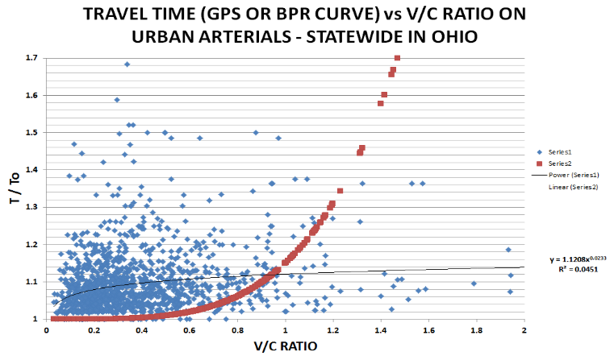
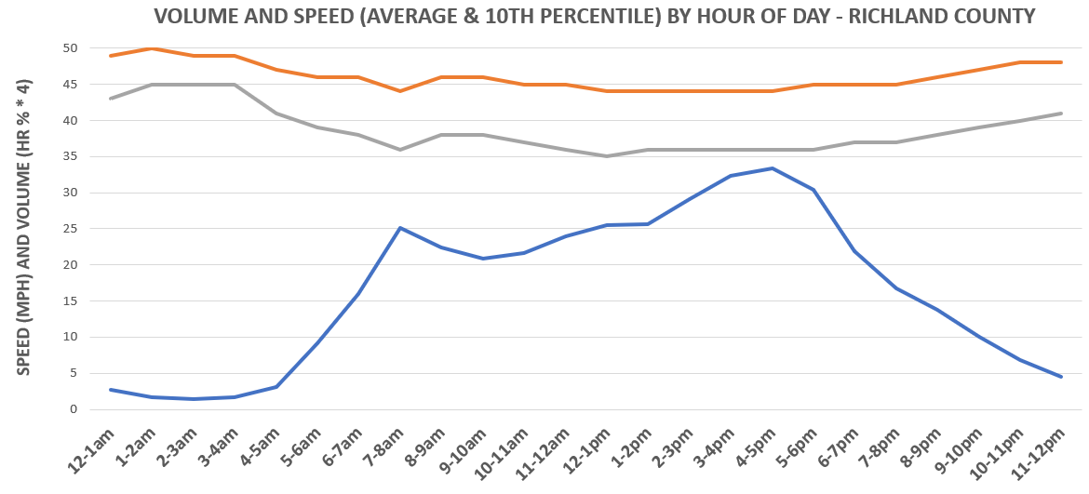
(done as part of) Faster, Better, Cheaper modeling…
Operations-level techniques (HCM & related) embedded in networks/ assignment for travel time, delay, and saturation flow estimates– 33 years
“Driveway” counts for trip generation (e.g. ITE) – 33 years
Area-wide Dynamic traffic assignment (& by season of year) – 18 years
Travel paths based in part on the variability of travel time – 13 years
(DTA is integrated within 4-step process as a feedback loop (instead of as a stand-alone model or part of ABM), while a separate loop estimates the “reliable” times for travel paths - if set to non-additive by link.)

Slide 6
Modeled Volume Error
(
Notes:
Lotsa of both STA and DTA models I’ve developed over the years are included here. The traditional modeling standard over the years (black line) I mostly just show to other modelers. Customers obviously expect zero error, the thick blue line representing typical sampling error in counts is what I use to defend results to them.

Slide 7
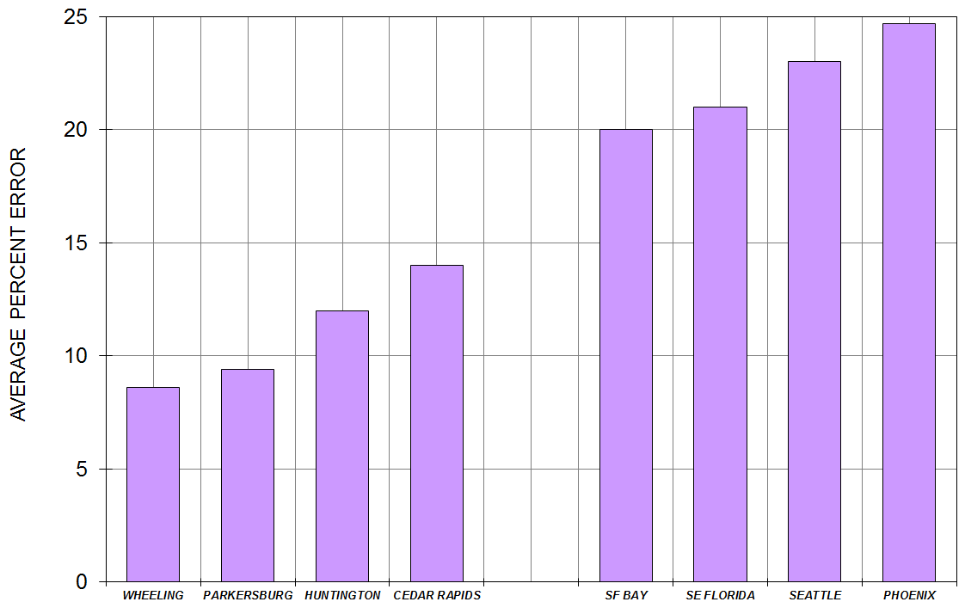
Modeled Travel Time Error (from the “floating car days”)
Average travel time errors (on urban streets) far lower than models from other regions (that rely on fixed capacities & VDFs).
Before discovering the “85/15” standard (developed for simulation models), I made use of 95% Confidence Intervals
Notes:
This is the first of 2-3 charts I lifted from a TRB paper I did w/AJH 4 years ago (if you want to see any documentation behind this). The ones I’ve done are on the left side, all using peak period floating car studies – I’ve done a couple since these that mostly rely on private GPS vendor data instead. (I presume the ones on right are still better than most, since actual documentation of them could be found. Problem is their reliance on VDFs…)
For a validation standard, I initially developed confidence intervals around sample average values, then found later that a couple of state DOTs have developed standards for simulation models that can apply here, based on an “85/15 rule” (85% of time the error is less than 15%).
Any “adjustments” done for validation of modeled travel times? Sometimes signal progression factors . . .
(And when you can’t get the travel times right, it doesn’t just affect the LOS/congestion forecasts – it also means zone-to-zone impedances aren’t right, and things like time/distance weightings or any bridge or screenline penalties are affected as well.)

Slide 8
Model error, the GPS probe data edition (road segments aggregated to vendor or RI corridors):

Slide 9
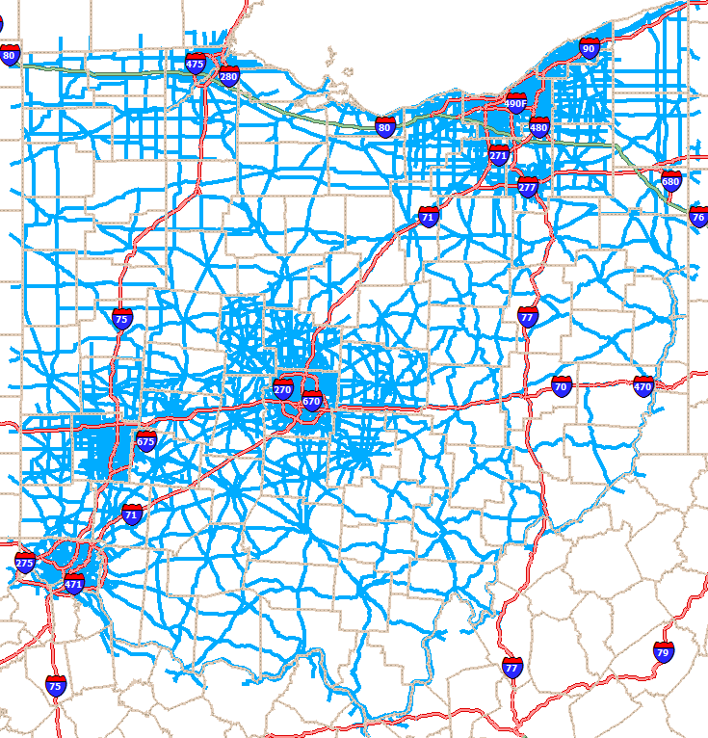
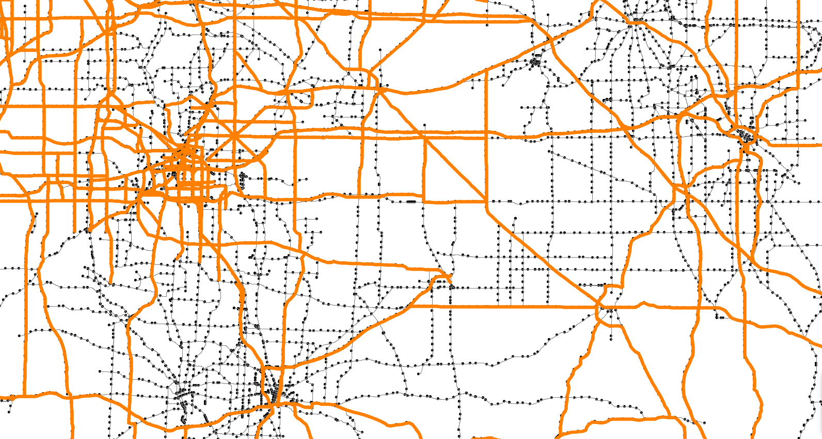
Combining data from various sources for models:
Floating car data good for initial coding of speeds in network (as it separates out intersection delay from “mid-block” travel speed.
On freeways & rest of NHS – NPMRDS data (already used for PM3) has separate speeds for auto and truck. (used for “truck penalties”)
Rest of road system- vendor’s XD network has both more granularity than TMC-based network (0.42 m average segment length vs 1.35 m) & more roadway coverage (53,000 directional miles statewide in Ohio vs 35,000), especially in smaller MPOs.
Notes:
So this summarizes what I’m thinking of to do for 2020 networks both MPO and statewide. We’d still start with the initial speed coding that came from the floating car studies, since that separates out the intersection delay from the “mid-block” speeds. But GPS can still provide the site-specific validation, since floating car was only done on a small number of roads. And by now a lot of you have had a chance to work with the PM3 data either thru RITIS or direct from INRIX, where we can get both car and truck data separate on the NHS that can be used for truck speed penalties 8 years ago I showed you the TMC network we still have in the map on the left, on the right you can see how it compares to the XD network (dashed line). Core area of Akron, not much different, but in urban areas below 500k population, a lot of difference.

Slide 10
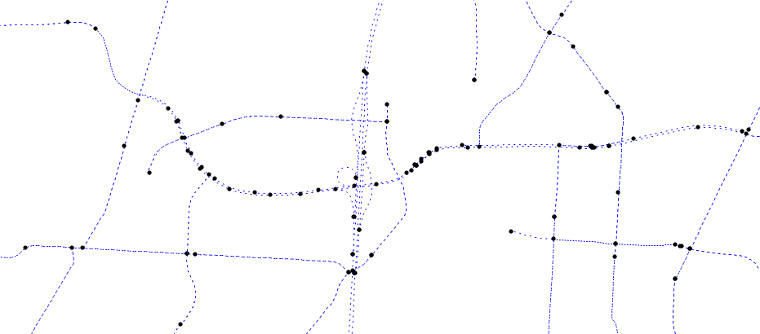
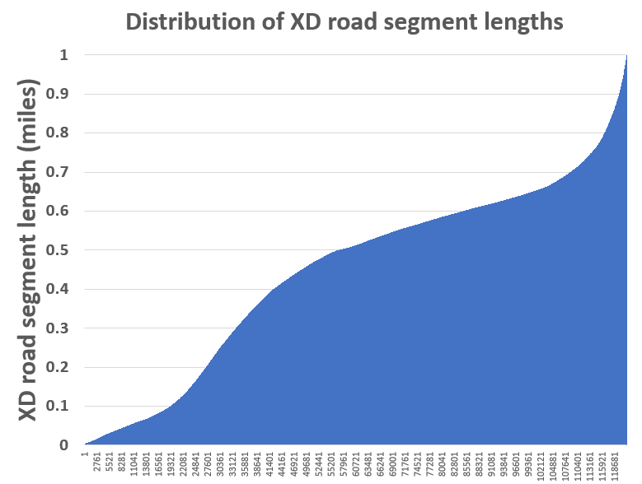
….but sometimes there’s too much granularity for model networks
Model segments may conflate to very small XD segments.
How to properly aggregate XD road segments for this use?
(can avoid for freeways, NPMRDS uses the TMC network)
Notes:
The one problem I found with the new XD network, when I first used it on validation of the Richland county model, is sometimes XD is TOO granular for good data joins between it and the travel model network. With TMC it was always one segment to several model segments, and with XD sometimes the other way around. The plot on the upper left shows an “extreme” case around the Polaris mall on the north side of Columbus. Not always like this (better exp later), but the CFD graph on the right shows that about ¼ of the segments statewide are less than ¼ mile. Sometimes the one of several that GIS-joins to the model segment is not the one that incorporates the intersection delay. So a means of aggregating them is needed. On the bottom, this finer granularity is on freeway XD segments as well. Our ITS section loves this, to be able to pinpoint problem locations quicker in real time, but for our needs ramp-to-ramp (TMC) usually sufficient.

Slide 11
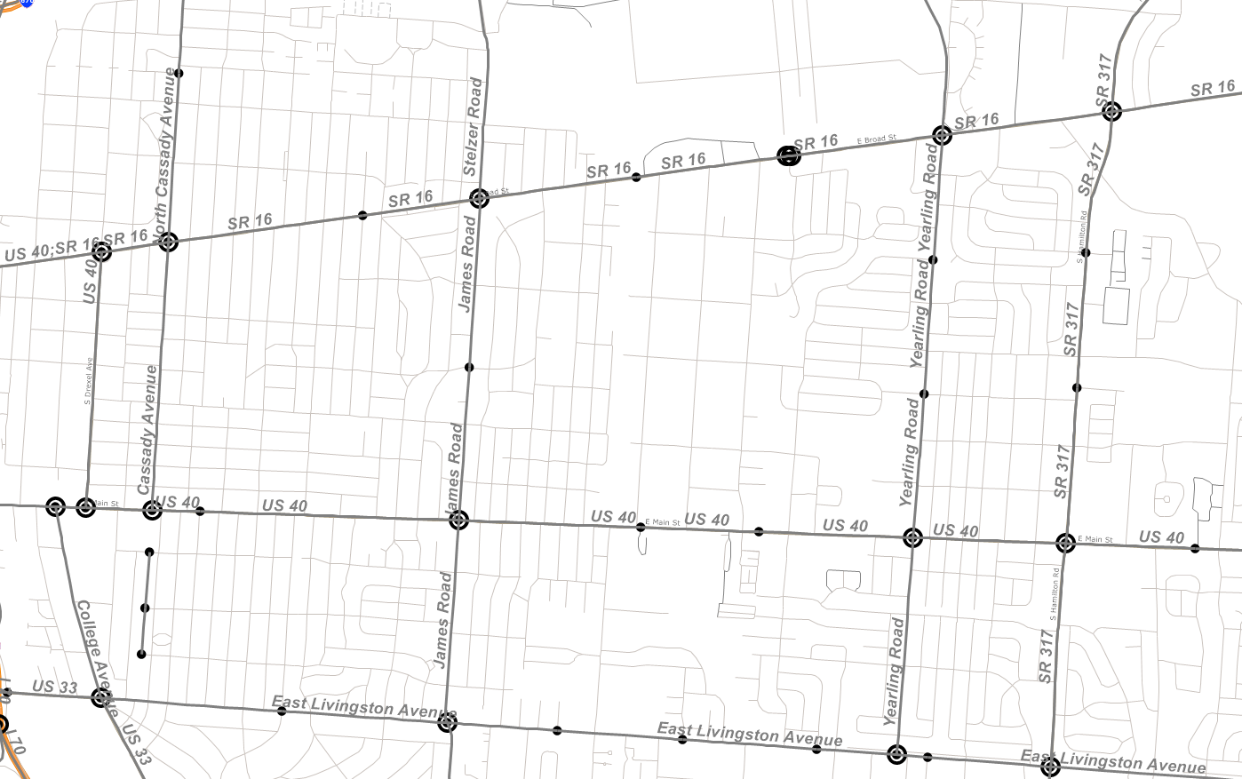
GIS procedure for segment aggregation:
Break up statewide XD network in 2, based on cardinal (NB/EB bearing) vs non-cardinal directions.
Find # of links at each node, connect dis-jointed segments
Filter out short links without network continuity (or data).
A “Simplify” procedure to aggregate segments between intersections (reduces the number of XD segments by over 2/3rds).
Notes:
Procedure based on the convention in TransCad including name, Maptitude or ESRI may have similar capability.
This shows a sample application of it for part of east Columbus, small nodes indicate 1 or 2 links connect but not an intersection in the XD network while large nodes show what remains after the application of this procedure. You can see one location where the segments didn’t literally connect in GIS, but need to. So when I re-do this procedure with the up-to-date version of XD, I’ll also be merging those nodes first.

Slide 12
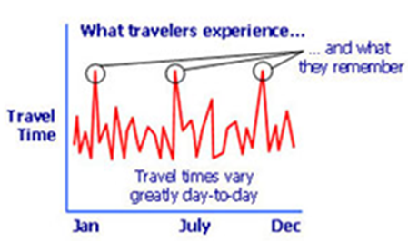
Part 2: Use of data on variability for estimating travel paths
From both local and Minnesota studies: only 1/3 of travelers on shortest time path, none on the shortest distance path - unless the same as shortest time path).
Why? Plenty of day-to-day variability in both link-level volumes and travel delays (as well as differences in traveler perceptions).
Use of variability of travel times in models born out of a sense that delay should somehow get more “weight” than other travel time

Slide 13
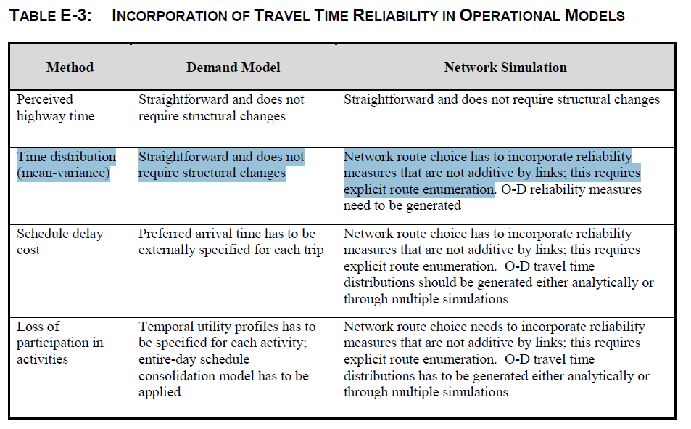
Notes:
Ask how I’m doing on time at this point, might need to “race” through the rest of the slides…..

Slide 14
Implementing Reliability in Path Building step:
Total Path Impedance (RR = reliability ratio)
Variance of Path Travel Time
Thru movements on successive links are correlated.
Marginal change in travel time standard deviation from selecting the next link:
So that for any path between an origin and destination:

Slide 15
Details of the Link-level Reliability calcs:
Path correction using MSA, vine building necessary.
Convergence found in a finite number of steps (via calculation of “path error” term).
Link travel time includes intersection delay, while standard deviation derived from the coefficient of variation equation
“Free” travel time t₀ includes intersection delays under low-flow conditions. (L=link length)
Calibration coefficients can vary by road type/ functional class

Slide 16
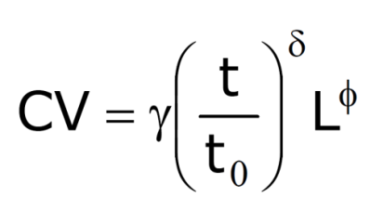
Reliability Parameters
Link Impedance = all other components + (reliability ratio)*t*CV

Slide 17
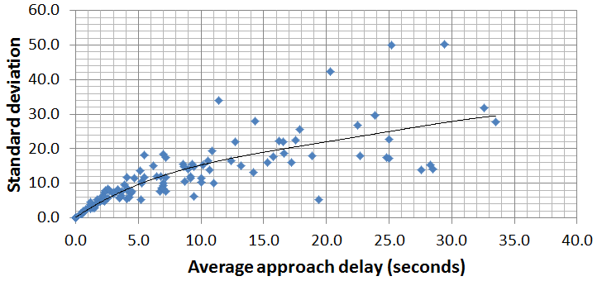
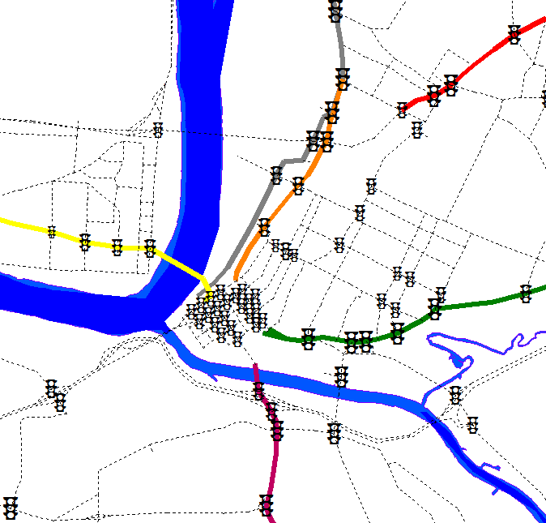
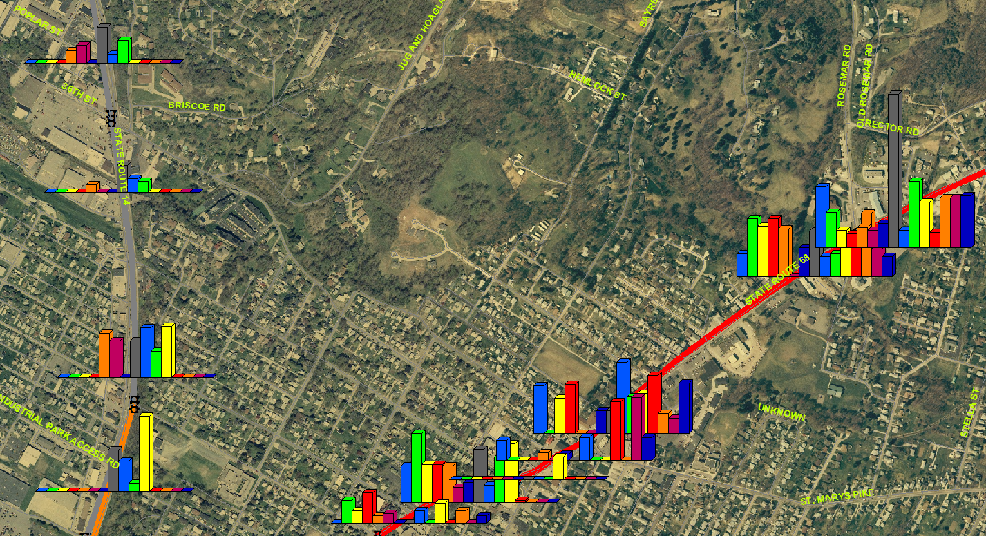
Variability in intersection delay from floating car survey with (relatively) large sample sizes from nearby MPO region
Initially from GPS data from the UK, then added “local” floating-car surveys:

Slide 18
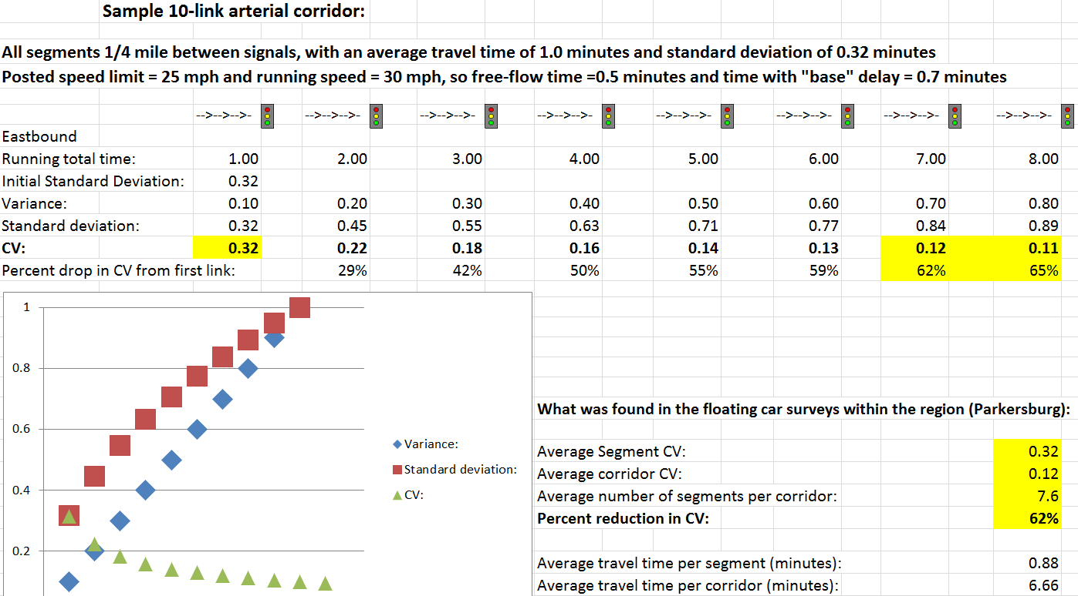
Travel time variability as a function of route length, or number of intersections

Slide 19
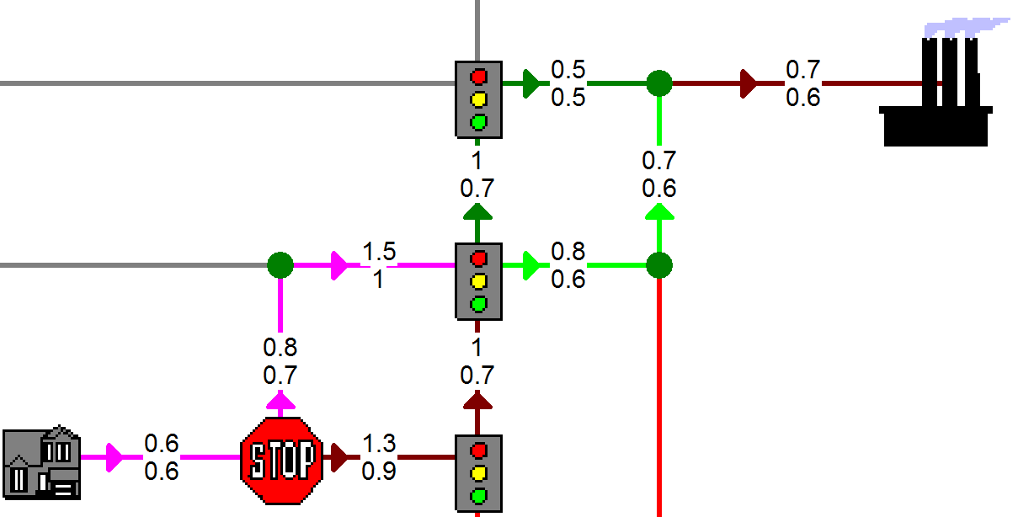
Simplified Example (average time/”free-flow” time): (All links are 0.25 miles with running speed=30 mph so “running” time=0.5 minutes)

Slide 20
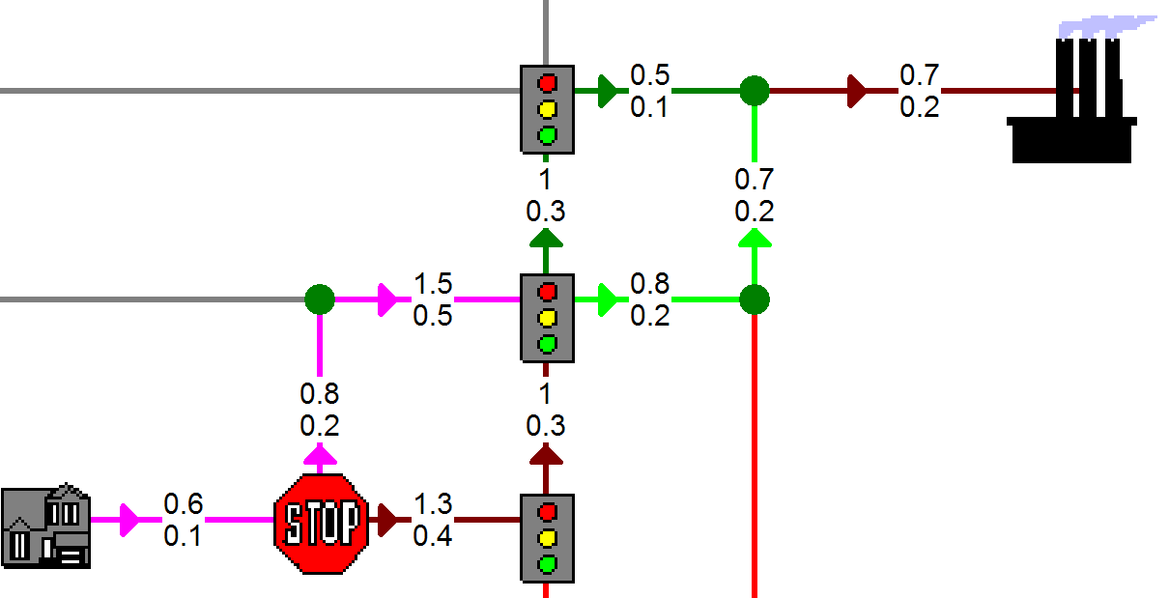
Path impedance with reliability (additive) (Posted: Average time / standard deviation)

Slide 21
Path impedance with reliability (NON-additive) (Posted: Average time / standard deviation)

Slide 22
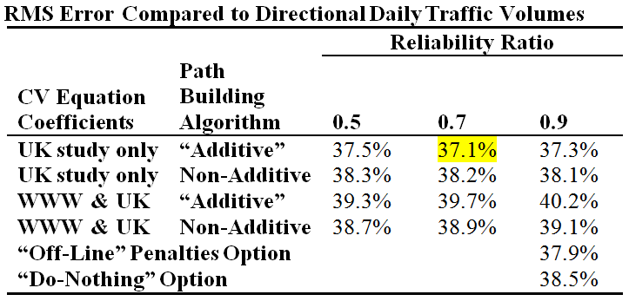
Results from first test on MPO model:
Number of Path building iterations has clear impact on model volumes but mixed on validation
Procedures tend to reduce impact of “worst” intersections
Counter-intuitively, equation values from UK study worked better than results from nearby-area floating car surveys
Virtually no differences among options for average travel time error (table shows the “bottom line” for volume error)

Slide 23
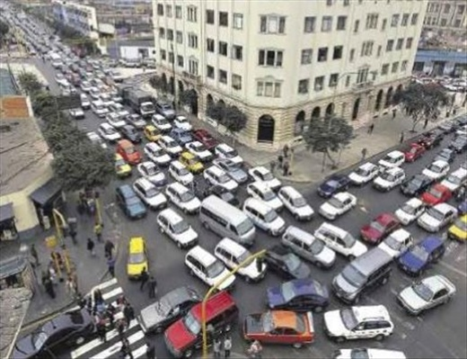
Questions?
sundaydriver8@gmail.com

